Slide 1

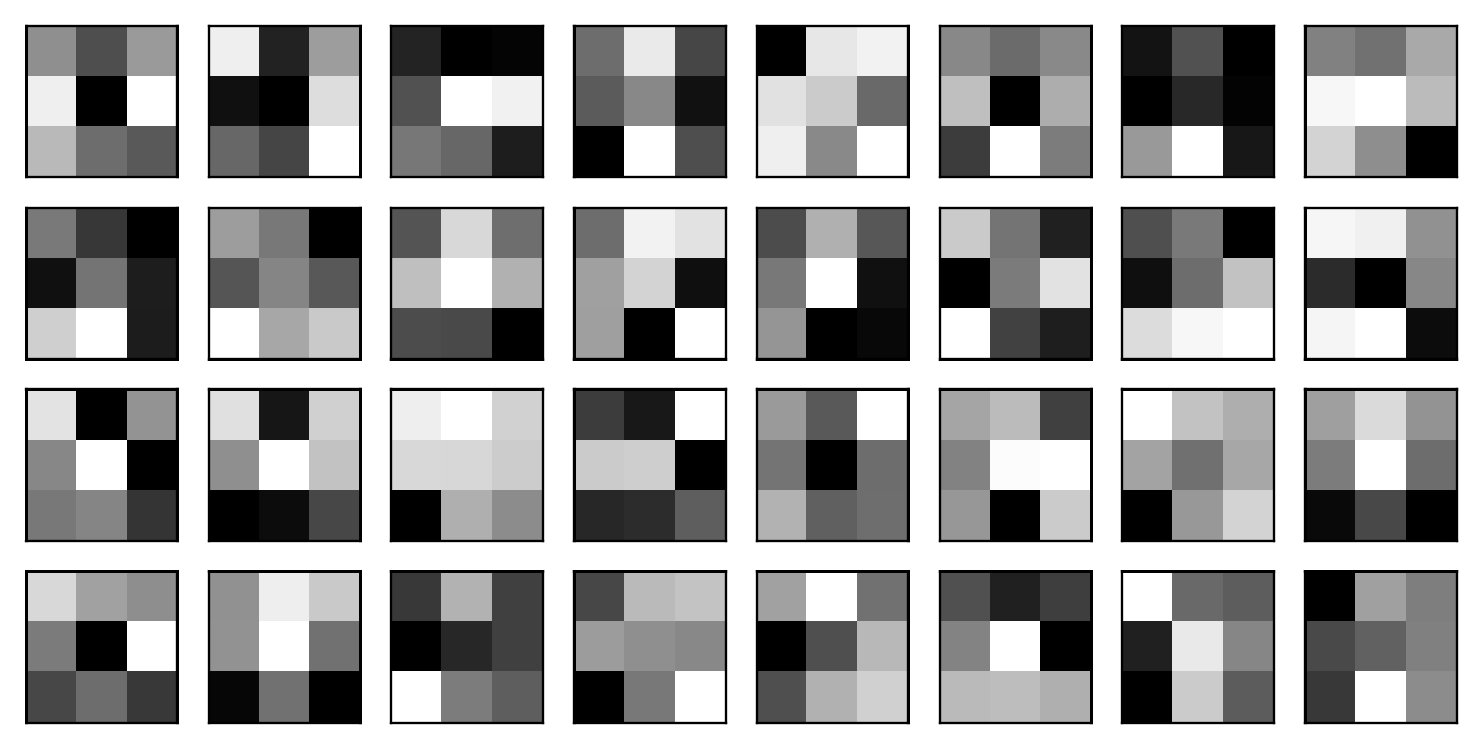
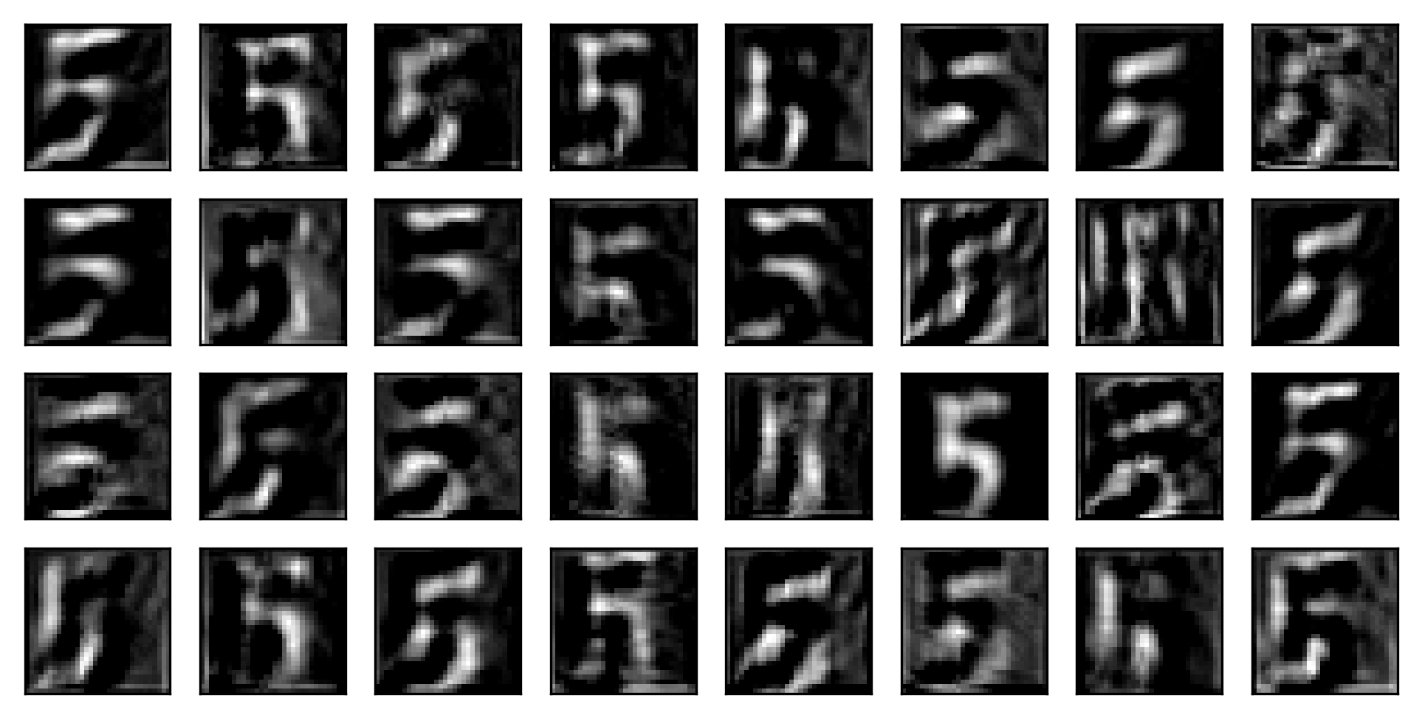
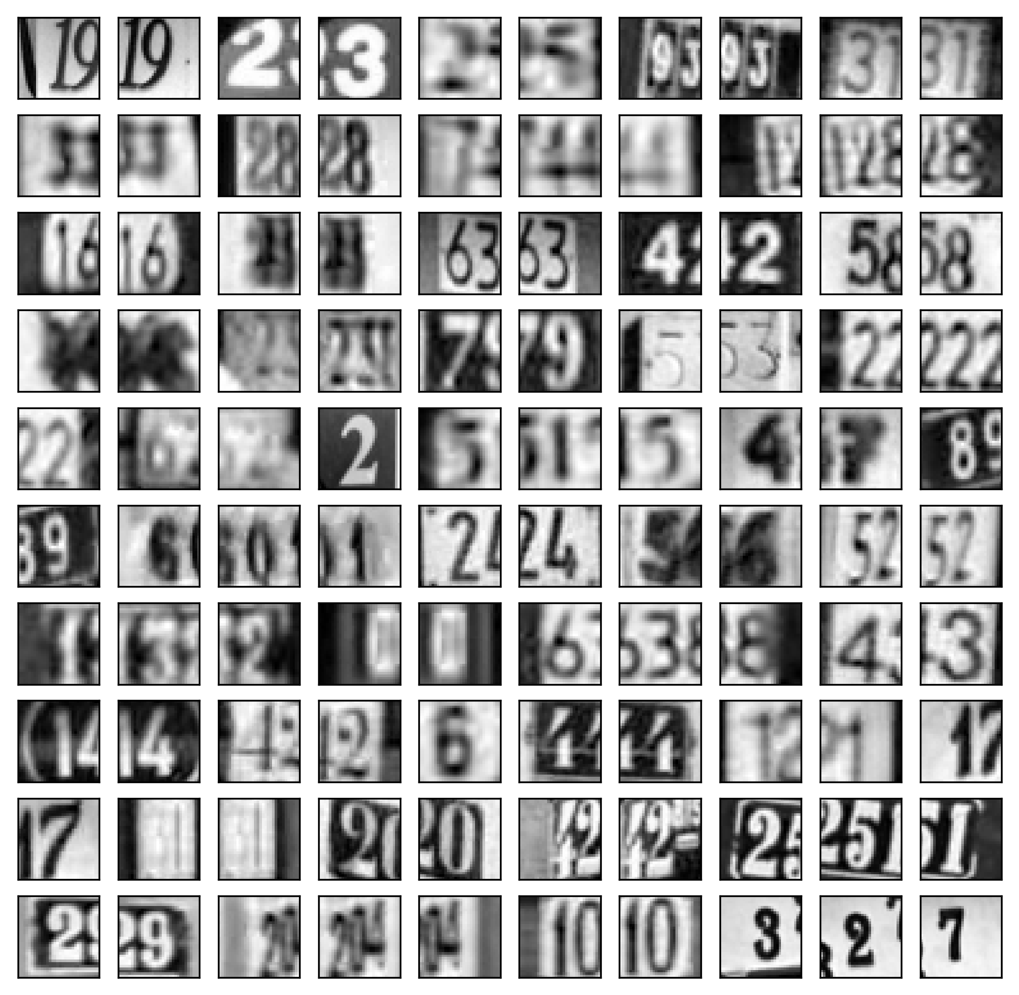
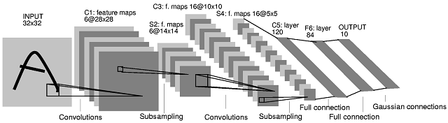
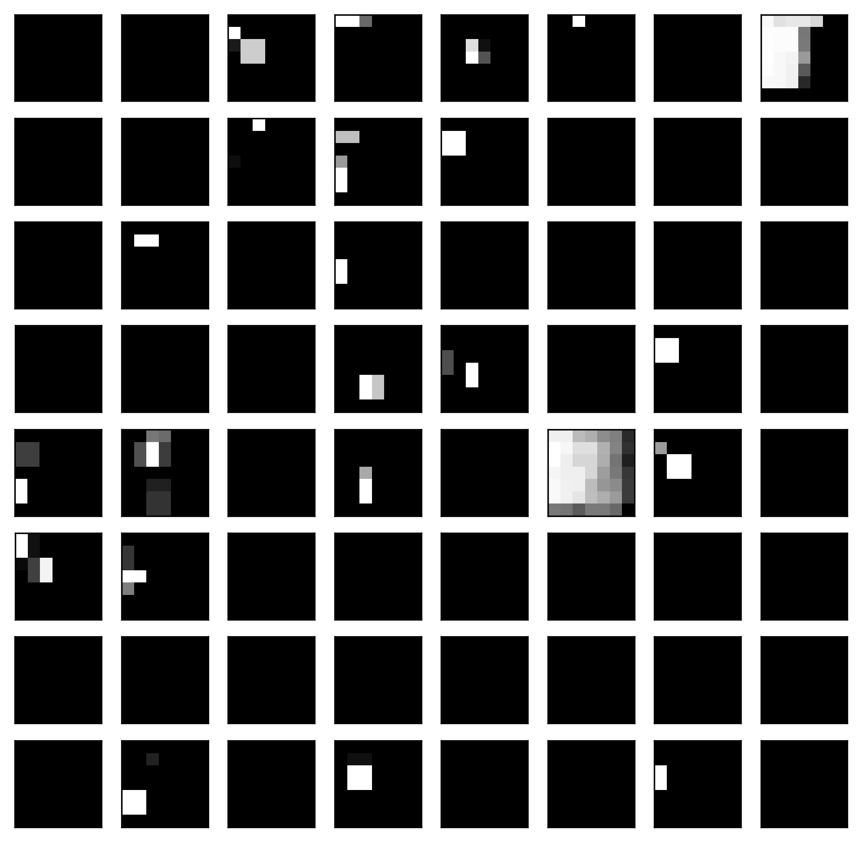
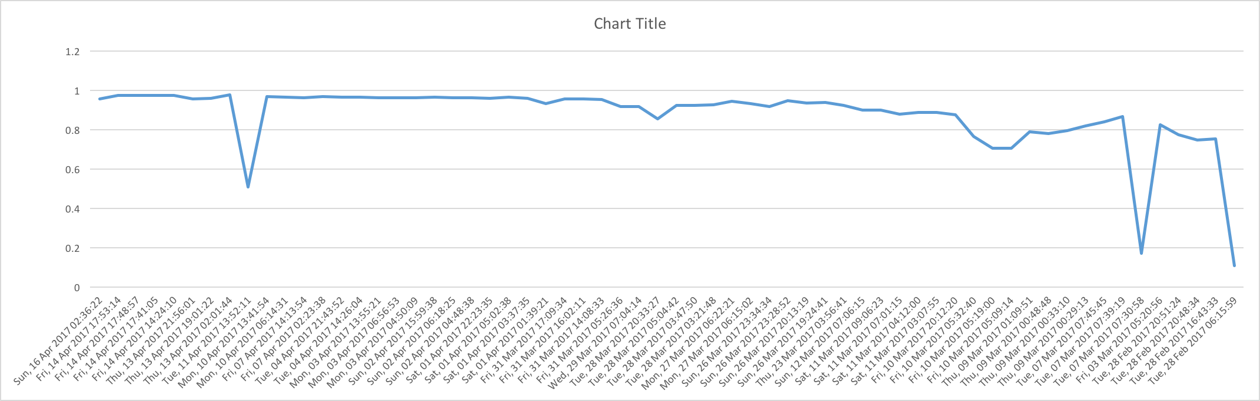
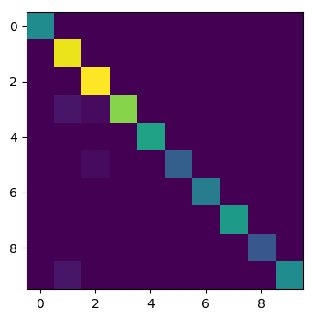
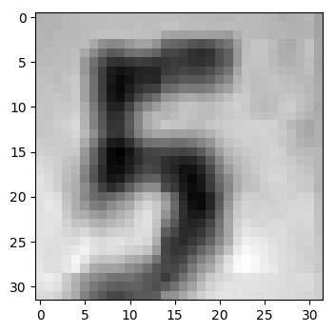
Convolutional NN’s for SVHN dataset
Guangyuan Yu¹, Andrew Wells²
1.Physics and Astronomy Department 2. Computer Science Department
Introduction
Pre-processing
SVHN is a real-world image dataset for developing machine learning and object recognition algorithms with minimal requirements on data pre-processing and formatting. SVHN is obtained from house numbers in Google Street View images. We get an 97.7% accuracy by a convolutional neural network (CNN). CNN are variations of multilayer perceptrons designed to use minimal amounts of preprocessing. CNN have wide applications in image and video recognition, recommender systems and natural language processing.
Data⇽R*0.3+G*0.59+B*0.11
Data⇽Data-mean
Data⇽Data/std
First layer filter weights
First convolutional result
We trained our model with GeForce 1060, fast training enable us to try more structures.
Our best results were using ReLU with local response normalization.
Fractional pooling eventually had better results than max pool.
We were unable to improve results significantly by shifting/tilting the images.
High accuracy usually comes with small lr and longtiem training.
Training results
Pictrue is from stackexchange
Our network
Structure | accuracy
11 CNN+FC +Res+lrn+extra +VOTER+fraction pool | 97.7
6 CNN+FC+ extra +lrn+fraction+voter | 96.6
6 CNN+FC+ extra+leaky+Relu+fraction | 96
6 CNN+FC+ extra+maxpool | 96.2
50 LAYER ResNet+extra | 95.5
20 Layer ResNet+extra | 92.3
20 Layer ResNet+FC | Not good.
6CNN+FC+flip | 94.5
6CNN+FC+cover | 93.8
6CNN+FC | 94.2
2 CNN+FC+cover | 89.9
2 CNN +FC | 88.7
2 CNN+ binaryzation | 76.9
2 CNN without padding | 78
Training progress
input:32:32:1
Conv: 5*5*32
Conv: 5*5*32
Conv: 5*5*32,pool
Conv: 3*3*64
Last pooling result
Conv: 3*3*64
Lessons Learned
Conv: 3*3*64,pool
Though increasing the depth of the network should improve accuracy, it can lead to other issues with numerical precision and training time that make it more practical to limit the depth of the network. With fixed number of parameters, using technique to design a better structure is important.
Conv: 3*3*128
Conv: 3*3*128
Conv: 3*3*128,pool
Short cut is the main idea of ResNet, we put it into our network to train faster
I save and restore the model very frequently so I don’t have the learning curve.
Finally the training accuracy is around 98% and validation accuracy around 96%
Conv: 3*3*256
Acknowledgements:
Conv: 3*3*256,pool
https://www.tensorflow.org/tutorials/deep_cnn
https://arxiv.org/pdf/1512.03385.pdf
http://cs231n.github.io/convolutional-networks/
FC 2048
Confusion matrix
Example
FC 10

